Slide 1

Design and Implementation of a Road Sign and Road State Mobile Notification Application
GROUP 15
1
TASK 5

Slide 2
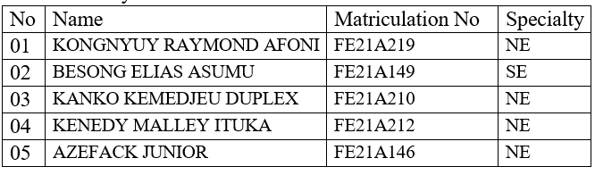
Members

Slide 3
UI DESIGN AND IMPLEMENTATION OUTLINE
2. User flow diagram
3. Use case diagram
4. UI Design
1. Design Principles
2

Slide 4

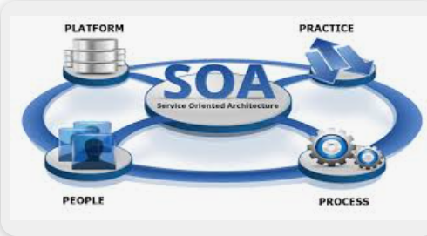
DESIGN PRINCIPLES
Human-Computer Interaction (HCI)
Service-Oriented Architecture (SOA)

Slide 5
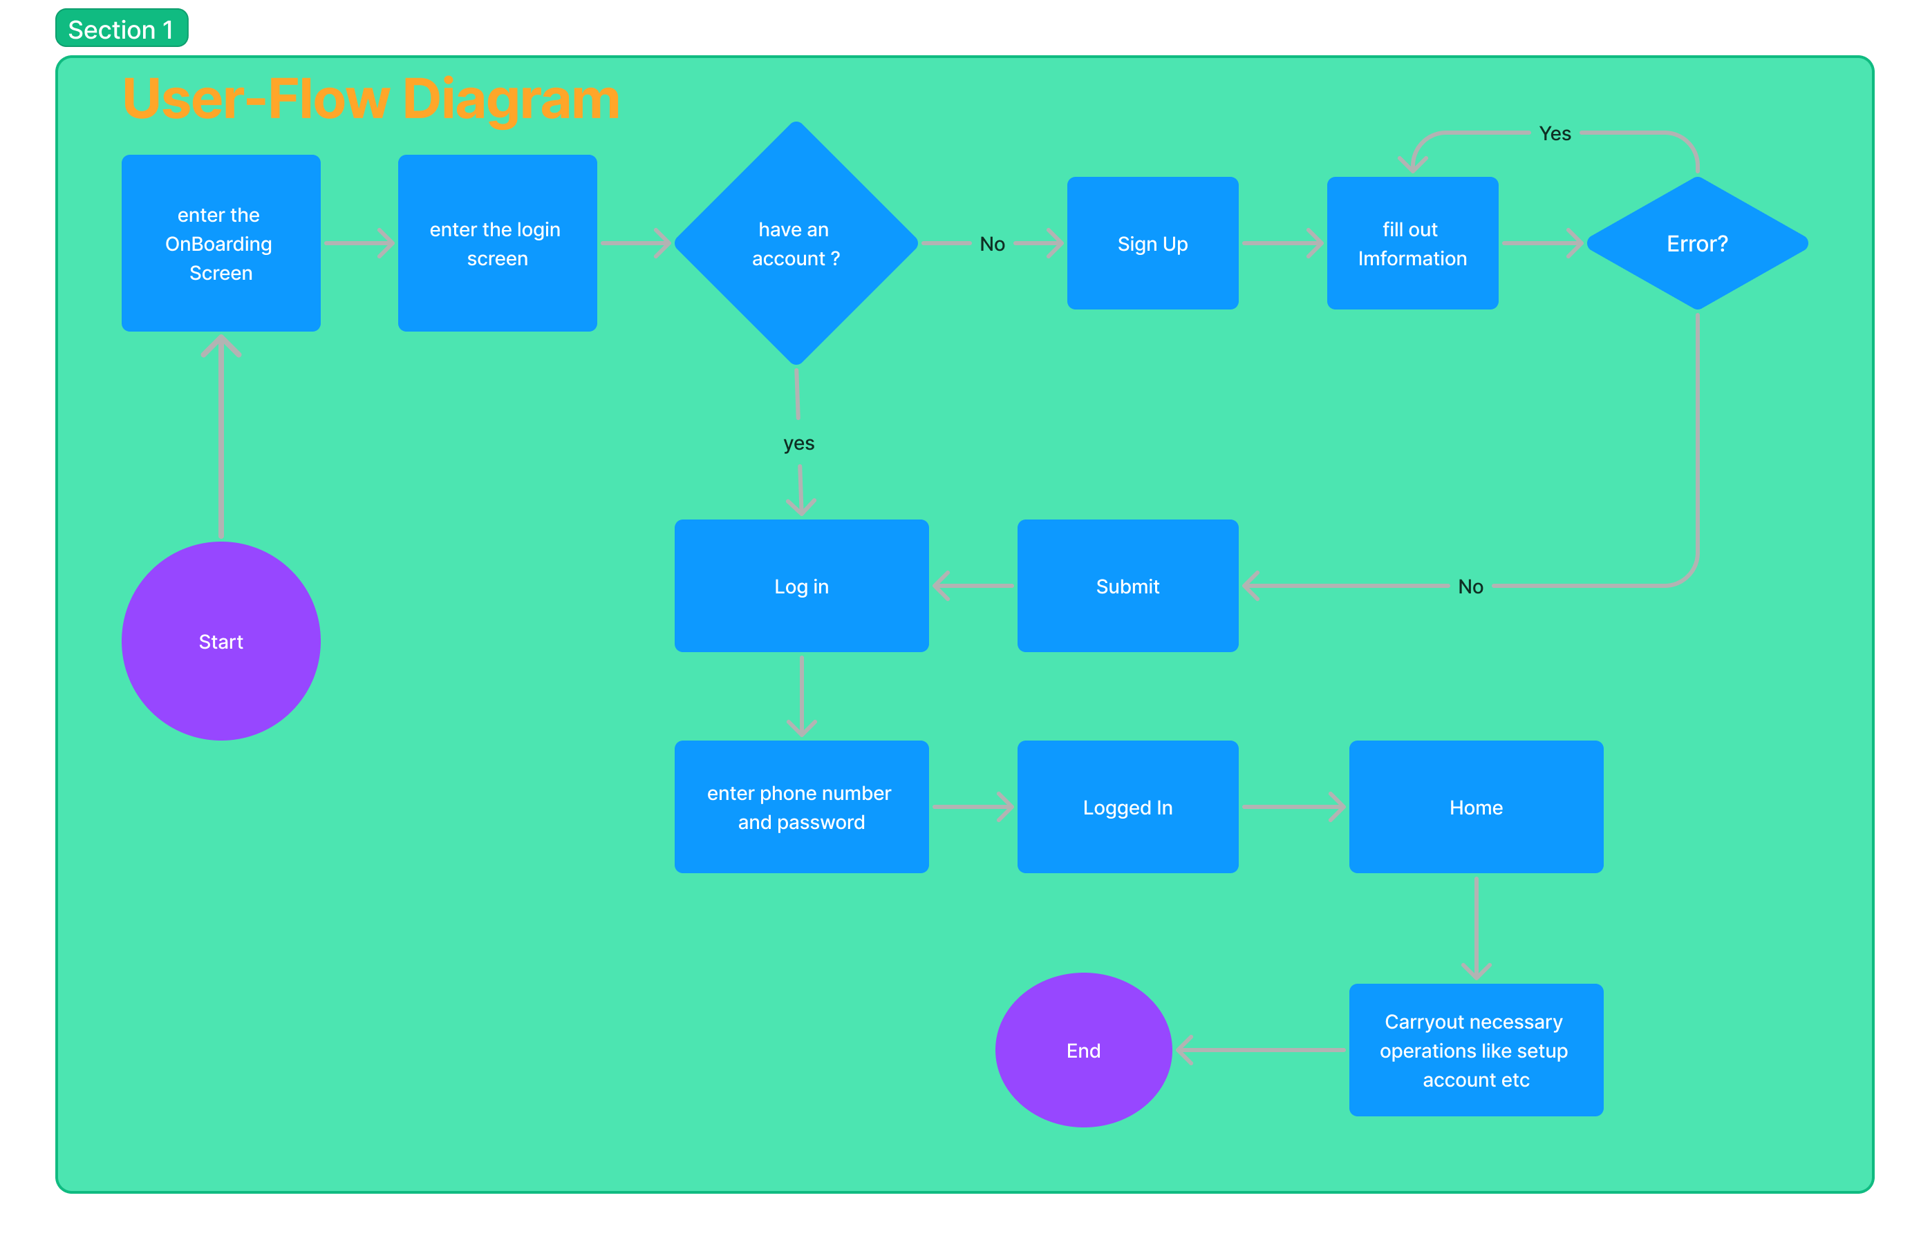

Slide 6
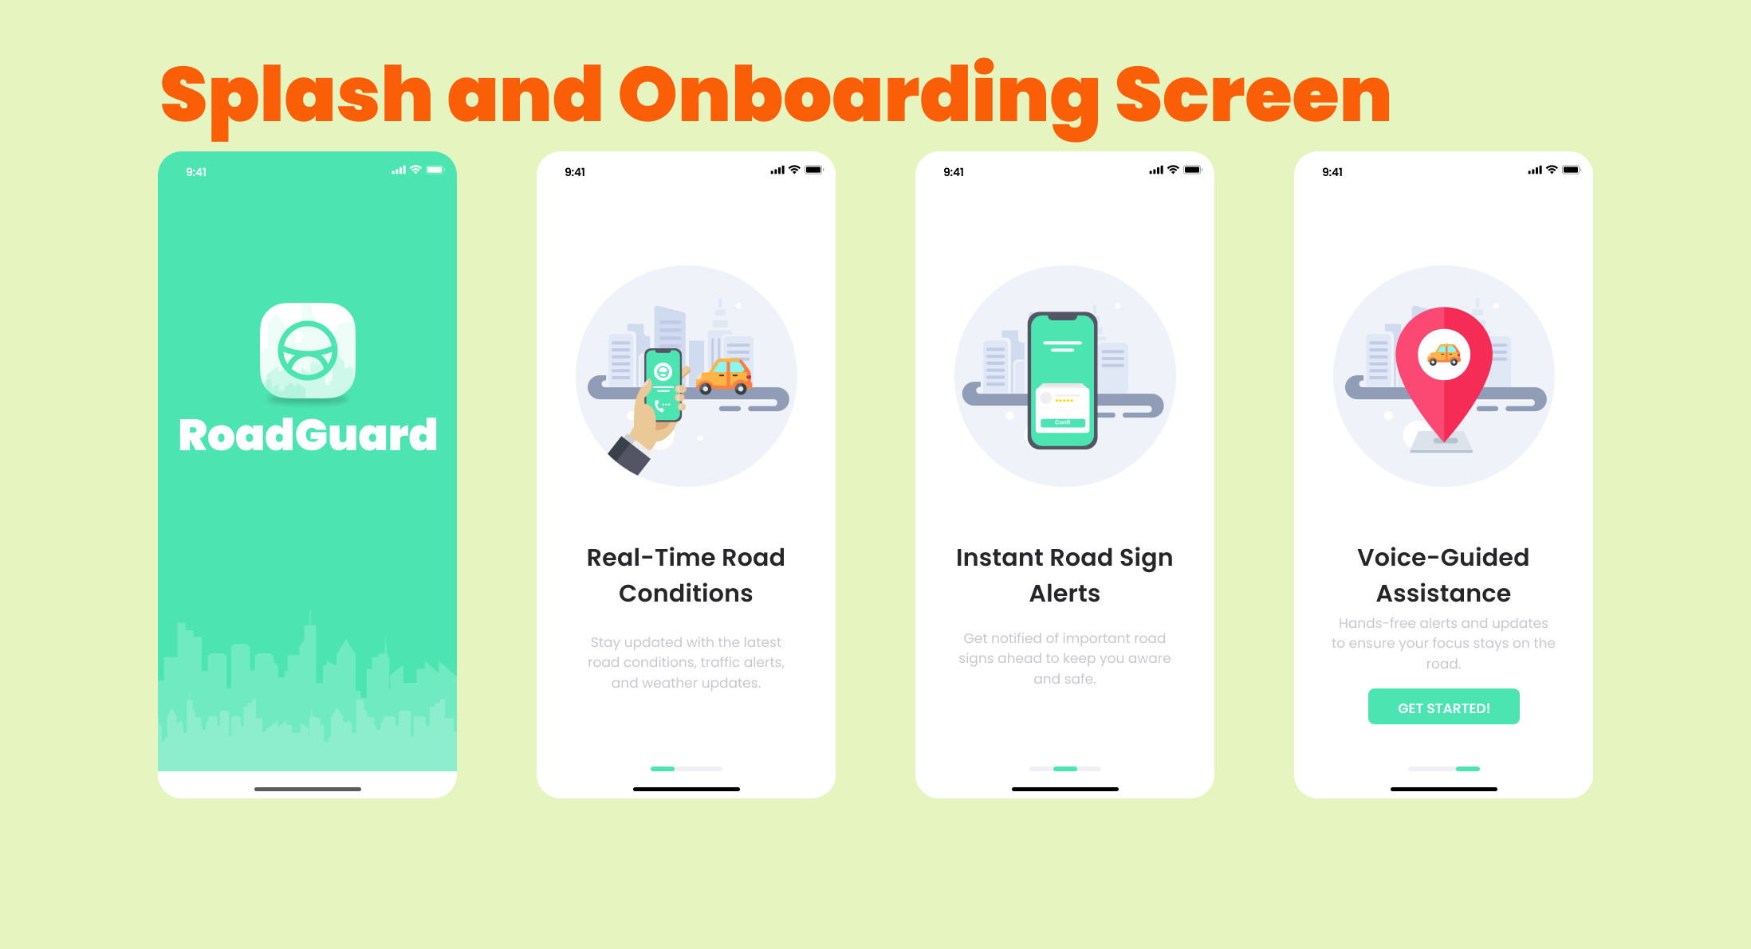

Slide 7
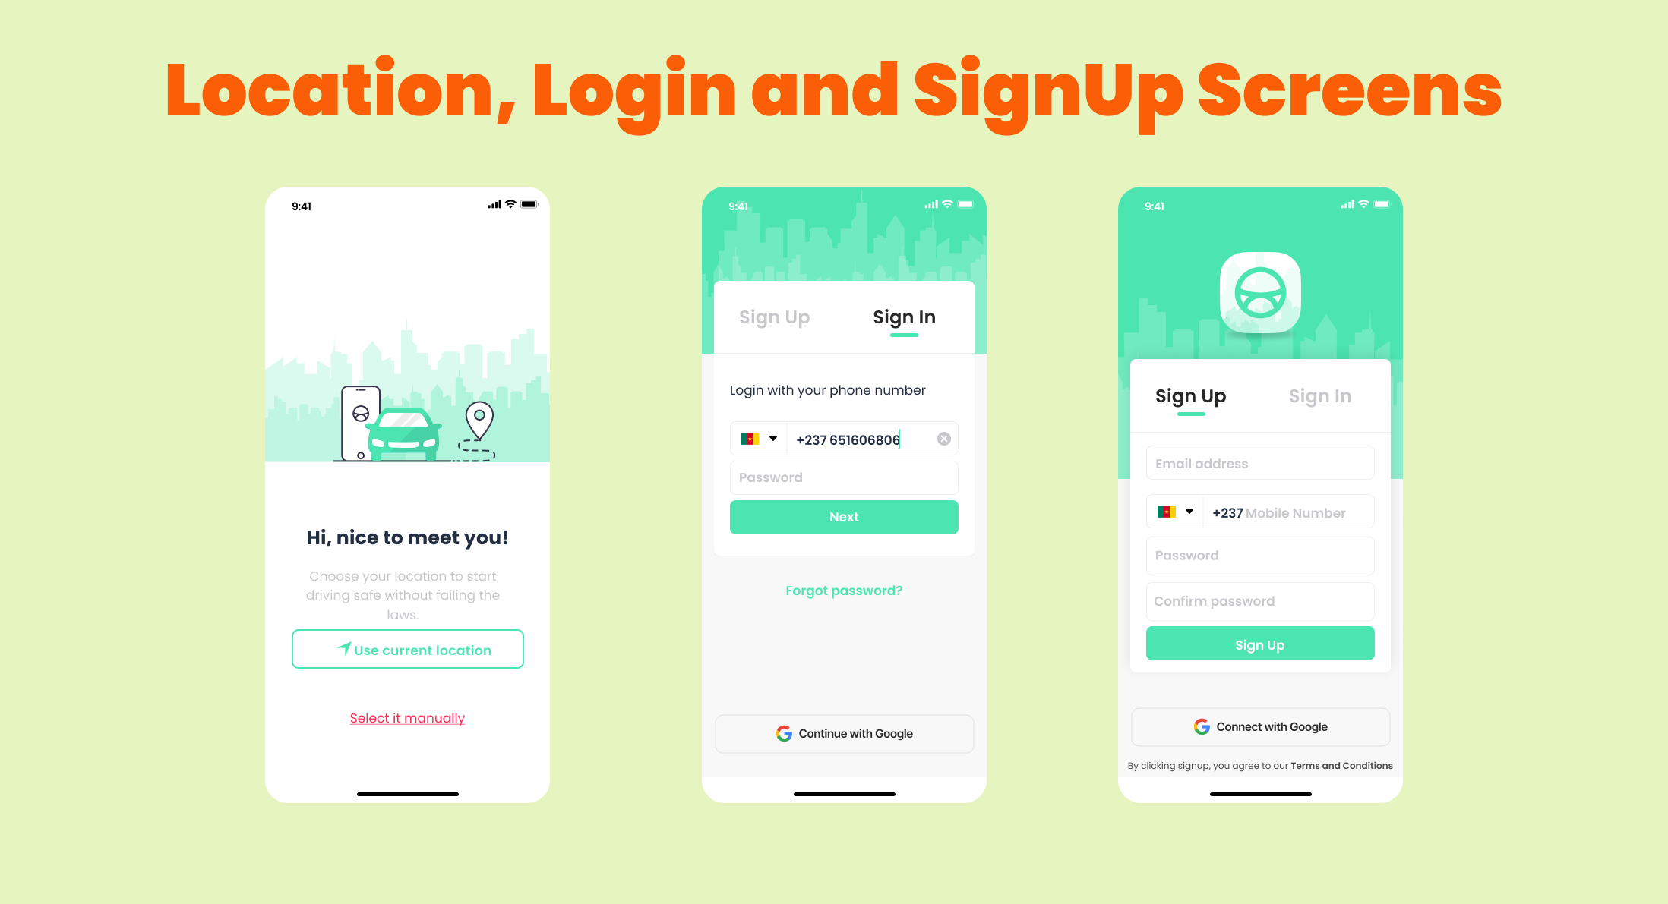

Slide 8
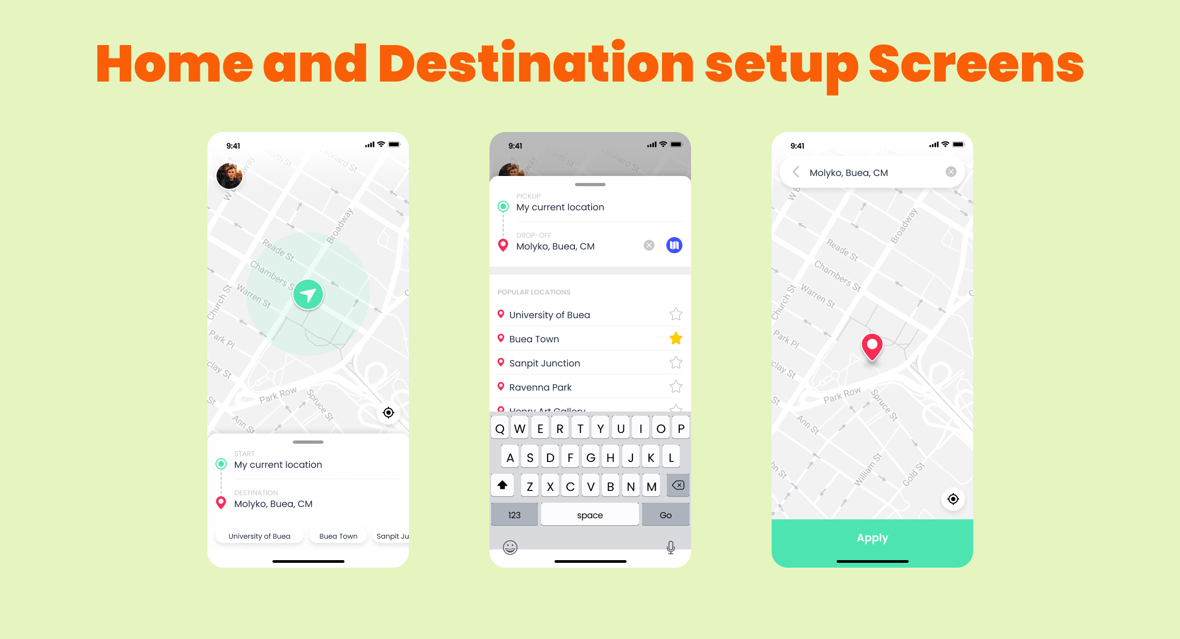

Slide 9
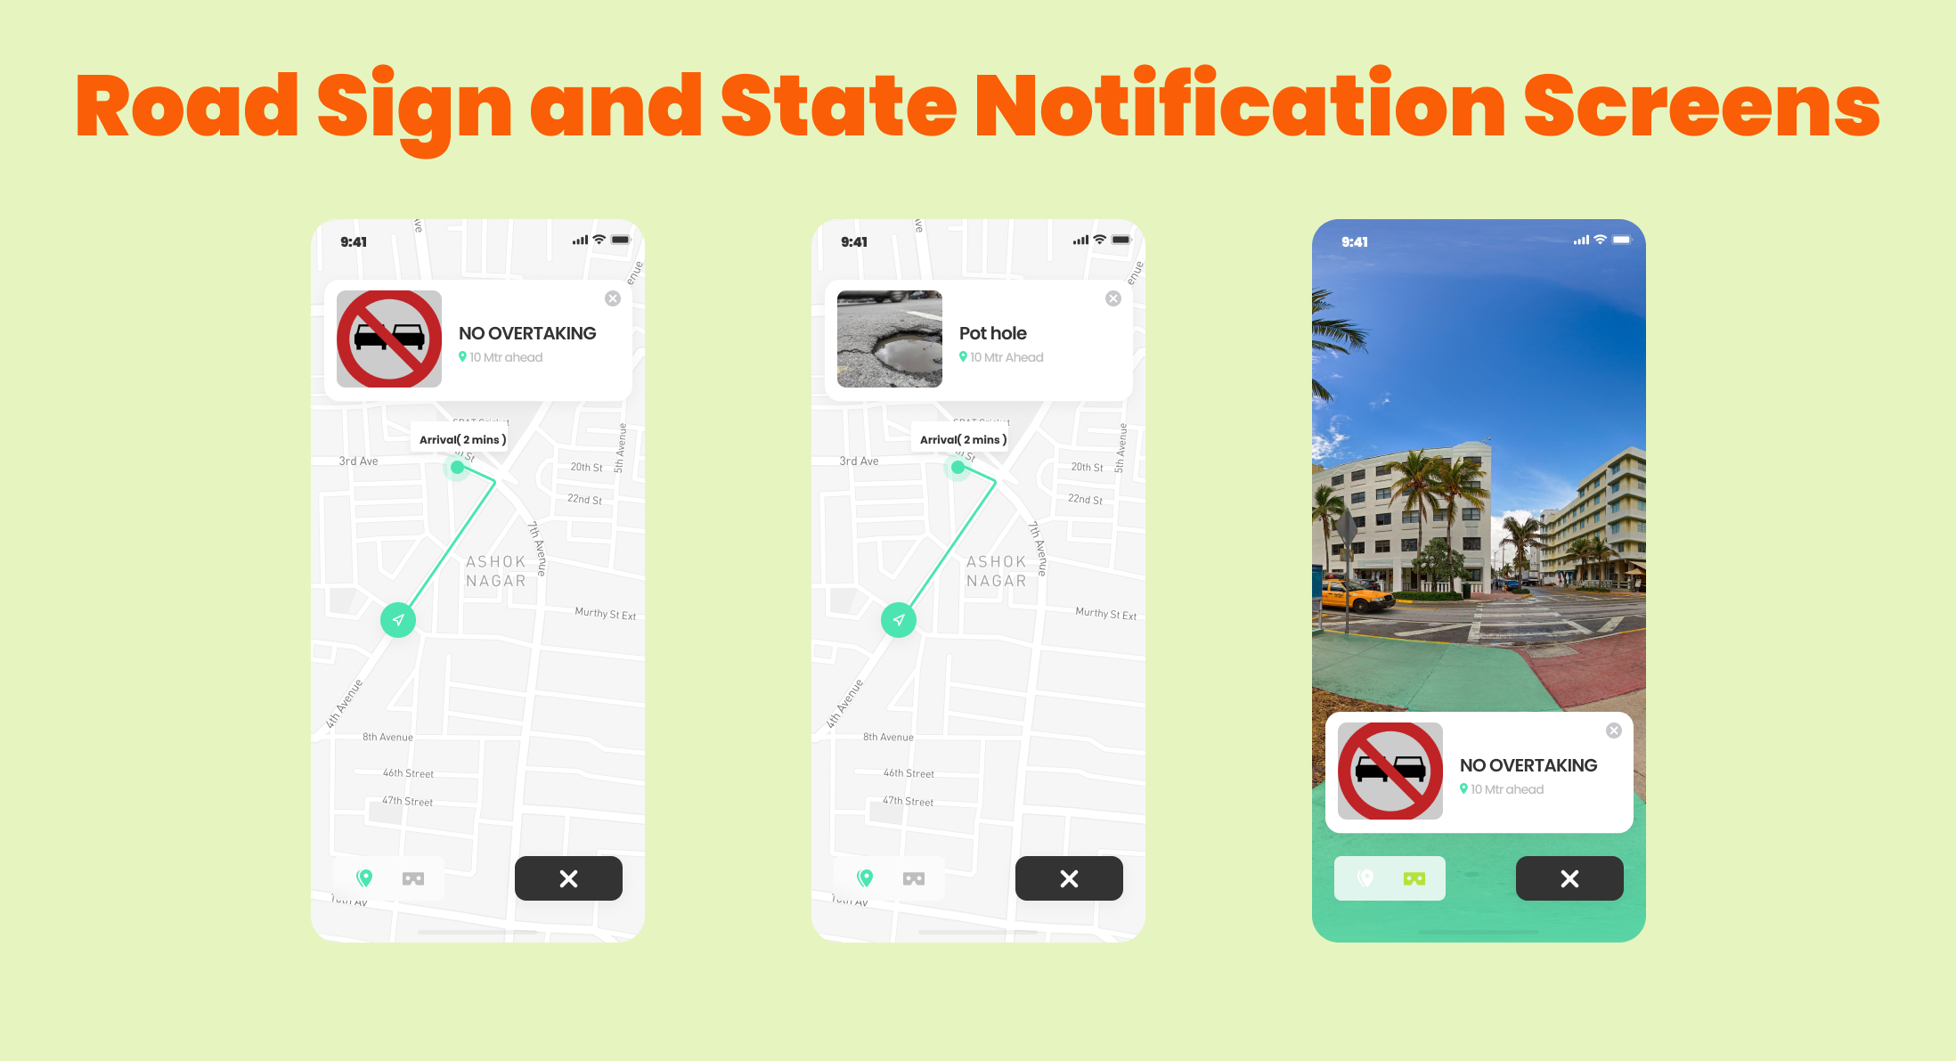

Slide 10
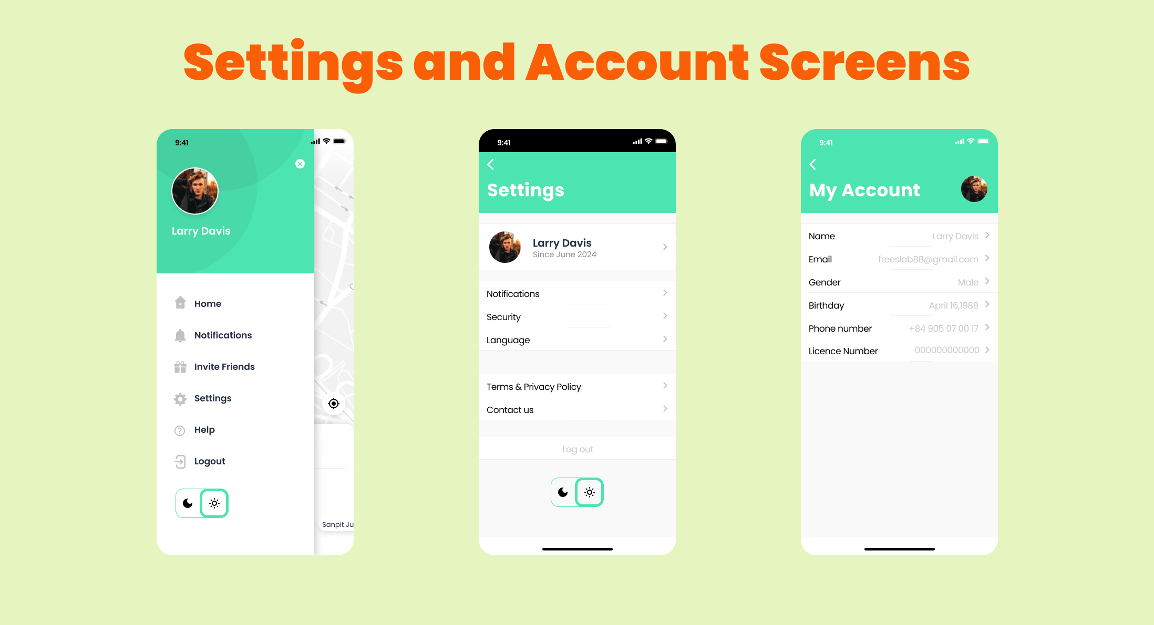

Slide 11
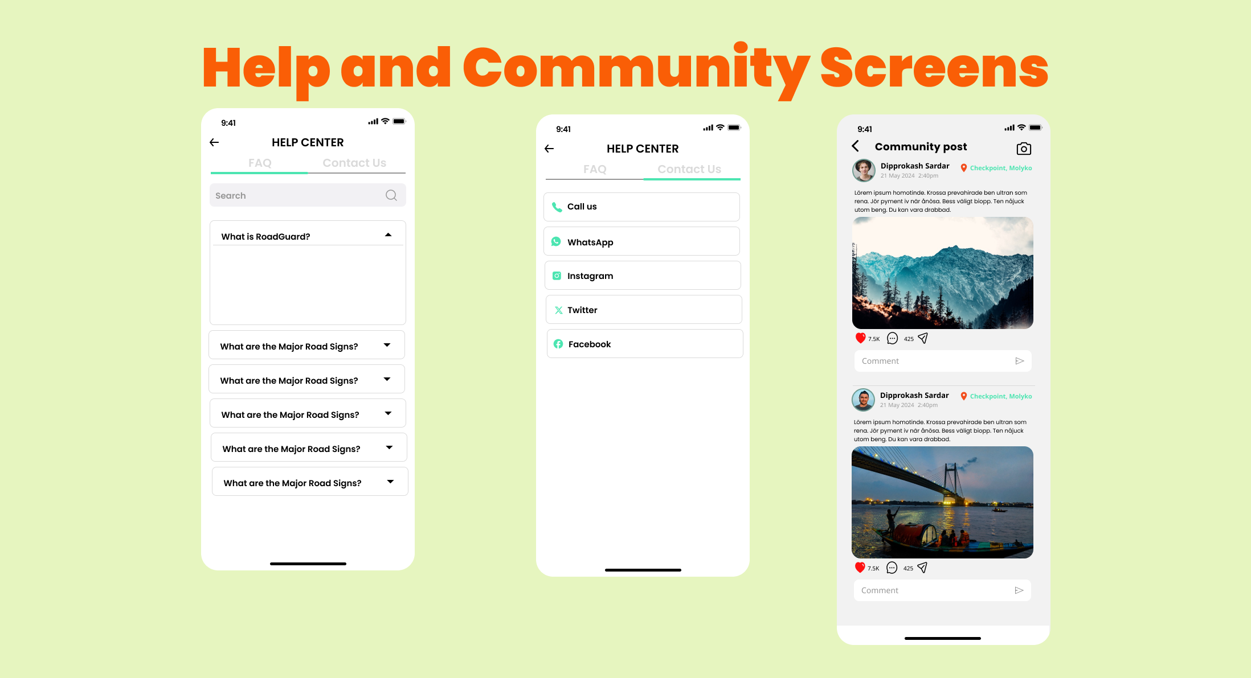

Slide 12
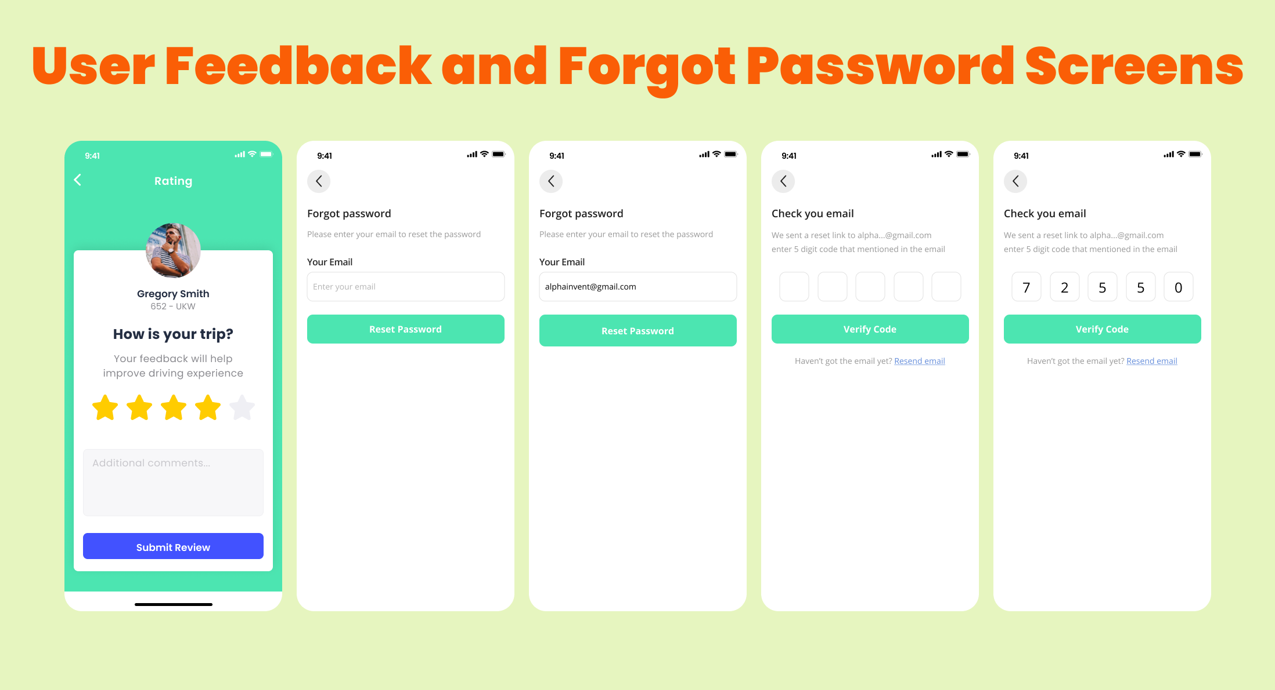

Slide 13
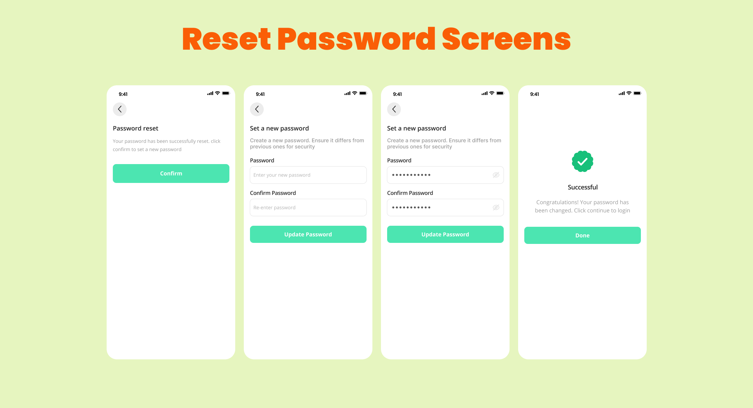

Slide 14

THANK
YOU!!!!!

